Slide 1

DRAFT 0.1 - NOT PUBLISHED
ORDER OF BATTLE
Air Forces
NOTE: This document and structure is a simplification and a compromise between real world organization and DCS limitation, while respecting that this is a hobby and not anyones job.
Notes:
Verson 0.1: Draft 1

Slide 2
Version control
Version number | Date | Information changed
0.1 (DRAFT) | 2020-04-26 | Initial version
Back to content
Back to Air Force

Slide 3
Content
Aircraft Roles
Squadron Types
Hierarchy
Air Force Organization
Back to content
Back to Air Force
3

Slide 4
Aircraft roles
Aircraft | Primary role | Secondary role | Name | Year
MiG-21 | Interceptor |  | FISHBED Old | 1959
MiG-23 | Fighter |  | Flogger | 1970
MiG-25 PD | Interceptor |  | Foxbat A | 1970
MiG-25 RBT | Reconnissance | Recon/bomber | Foxbat B | 1970
MiG-27K | Ground attack |  | Flogger D/J | 1975
MiG-29A | Fighter | Ground attack | FULCRUM | 1982
MiG-29S | Fighter | Ground attac | FULCRUM-S | 1982
MiG-31 | Interceptor |  | FOXHOUND | 1981 | Replace Mig-25
SU-17 M4 | Fighter bomber |  | FITTER-K | 1980
SU-24 M | Attack (A-G) |  | FENCER-D | 1979
SU-24 MR | Reconaissance |  | FENCER-E | 1980
SU-25 | CAS |  | FROGFOOT | 1981
SU-25 T | Anti-tank |  |  | 1991
SU-25 TM | Attack |  |  | 2008
SU-27 | Fighter | Fighter escort | FLANKER | 1985
SU-30 | Fighter/attack | Deep interdiction | FLANKER-C | 1996 | Similar to F15E
SU-33 | Fighter |  | FLANKER-D | 1998 | Carrier
SU-34 | Fighterbomber | Strike | FULLBACK | 2006
TU-142 | ASW | Anti-ship | BEAR | 1972
TU-160 | Strategic bomber |  | BLACKJACK | 1987
TU-22 M3 | Strategic bomber | Anti-ship | BACKFIRE-C | 1972
TU-95 MS | Cruise Missiles |  | BEAR-H | 1981
A-50 | AWACS |  | MAINSTAY | 1984
AN-26 B | Transport |  | CURL | 1970
AN-30 M | Reconaissance |  | CLANK | 1968
IL-78 M | AAR |  | MIDAS | 1987
IL-76 MD | Transport |  | CANDID | 1974
YAK-40 | VIP transport |  | CODLING | 1968
Back to content
Back to Air Force

Slide 5
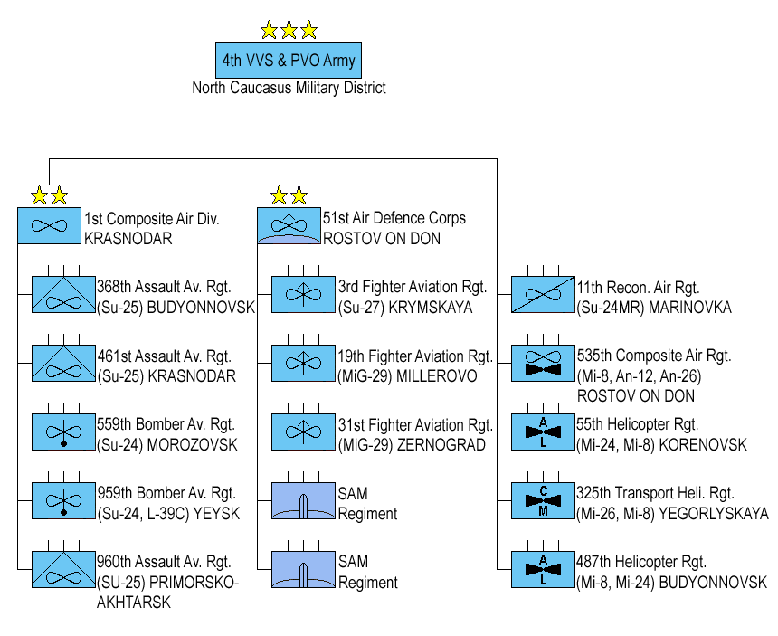
Squadron types
Bomber
SU-24 / SU-30 / SU-34
Fighter
MiG-23/MiG-29 / SU-27 / SU-30 /SU-33
Air Force
Heavy bomber
TU-160/ TU-22 /TU-95
Air Division
Assault
MiG-27/ MiG-29/SU-17/ SU-25 / SU-34
Reconissance
SU-24 MR/ MiG-25 RBT/ AN-30
Air Regiment
Interceptor
MiG-21 / MiG-25 / MiG-31
Air Squadron
Tanker
IL-78
Transport
AN-26B/IL-76/YAK-40
Airborne Early Warning
A-50
Anti-ship
TU-22 /TU-142
Bomber Aviation Regiment
Assault Aviation Regiment
Fighter Aviation Regiment
SU-24
SU-25
SU-27
MiG-29
Back to content
Back to Air Force

Slide 6
Hierarchy
Air Force
Highest echelon in a sector or country. Led by a 3-star general. Will normally have 3 Divisions.
Air Division
A Air Division may have several regiments of various types. Led by a 2-star general.
Air Regiment
A regiment have the same mission set. Each regiment have 2-4 squadrons with different types of aircraft. Led by a 1-star general
Air Squadron
Smallest organization in the Air Forces. Consist of same type of aircraft. Equipped with 6-12 aircraft depending on what kind of squadron
The enemy force may have several numbered Air Force’s in its structure (it will vary based on the campaign/event). However the numbered Air Forces will have a similar structure
Example: Russia may have the 2nd Air Force and 4th Air Force in 2 different sectors.
Back to content
Back to Air Force

Slide 7
Air Force Organization
Air Force
Air Force
Bomber Division
Air Defense Division
Composite Air Division
Bomber
Air Division
Bomber Aviation Regiment
Fighter Aviation Regiment
Tanker Aviation Regiment
Fighter
Bomber Aviation Regiment
Fighter Aviation Regiment
Transport Aviation Regiment
Air Regiment
Assault Aviation Regiment
Fighter Aviation Regiment
Reconnisance Regiment
Heavy bomber
Air Squadron
Assault Aviation Regiment
Interceptor Aviation Regiment
Airborne Early Warning
Assault
Heavy Bomber Aviation Regiment
Anti-ship Regiment
Reconissance
Interceptor
Tanker
Transport
Airborne Early Warning
Back to content
Back to Air Force

Slide 8
Bomber Aviation Regiment
Bomber Aviation Regiment
Air Force
Bomber
Air Division
Fighter
Air Regiment
Heavy bomber
Air Squadron
Assault
Reconissance
Interceptor
Tanker
Transport
Airborne Early Warning
Back to content
Back to Air Force

Slide 9
Heavy Bomber Aviation Regiment
Heavy Bomber Aviation Regiment
Air Force
Bomber
Air Division
Fighter
Air Regiment
Heavy bomber
Air Squadron
Assault
Reconissance
Interceptor
Tanker
Transport
Airborne Early Warning
Back to content
Back to Air Force

Slide 10
Assault Aviation Regiment
Assault Aviation Regiment
Air Force
Bomber
Air Division
Fighter
Air Regiment
Heavy bomber
Air Squadron
Assault
Reconissance
Interceptor
Tanker
Transport
Airborne Early Warning
Back to content
Back to Air Force

Slide 11
Fighter Aviation Regiment
Fighter Aviation Regiment
Air Force
Bomber
Air Division
Fighter
Air Regiment
Heavy bomber
Air Squadron
Assault
Reconissance
Interceptor
Tanker
Transport
Airborne Early Warning
Back to content
Back to Air Force

Slide 12
Interceptor Aviation Regiment
Interceptor Aviation Regiment
Air Force
Bomber
Air Division
Fighter
Air Regiment
Heavy bomber
Air Squadron
Assault
Reconissance
Interceptor
Tanker
Transport
Airborne Early Warning
Back to content
Back to Air Force

Slide 13
Reconissance Aviation Regiment
Reconissance Aviation Regiment
Air Force
Bomber
Air Division
Fighter
Air Regiment
Heavy bomber
Air Squadron
Assault
Reconissance
Interceptor
Tanker
Transport
Airborne Early Warning
Back to content
Back to Air Force

Slide 14
Anti-ship Aviation Regiment
Anti-ship Aviation Regiment
Air Force
Bomber
Air Division
Fighter
Air Regiment
Heavy bomber
Air Squadron
Assault
Reconissance
Interceptor
Tanker
Transport
Airborne Early Warning
Back to content
Back to Air Force

Slide 15
Tanker Aviation Regiment
Tanker Aviation Regiment
Air Force
Bomber
Air Division
Fighter
Air Regiment
Heavy bomber
Air Squadron
Assault
Reconissance
Interceptor
Tanker
Transport
Airborne Early Warning
Back to content
Back to Air Force

Slide 16
Transport Aviation Regiment
TransportAviation Regiment
Air Force
Bomber
Air Division
Fighter
Air Regiment
Heavy bomber
Air Squadron
Assault
Reconissance
Interceptor
Tanker
Transport
Airborne Early Warning
Back to content
Back to Air Force

Slide 17
AEW Regiment
AEW Regiment
Air Force
Bomber
Air Division
Fighter
Air Regiment
Heavy bomber
Air Squadron
Assault
Reconissance
Interceptor
Tanker
Transport
Airborne Early Warning
Back to content
Back to Air Force

